Slide 1
Sentiments Toward Energy Sources and Sustainable Technologies: A Twitter Analysis
Jameson Schryer
MSDS 696

Slide 2
Situation
The energy industry is undergoing many rapid transformations worldwide
These transformations surround the way energy is generated, distributed, and consumed
Consumers and energy companies alike are interested in the benefits of energy efficiency, renewables, and electric vehicles
The benefits of these technologies include savings for customers, decreased carbon emissions, and generation/ infrastructure savings for energy companies
This begs the question, are individuals becoming more receptive to these technologies?

Slide 3

Research Question
With this rapidly changing energy landscape, how have consumer’s opinions changed on energy related topics and technologies in the past decade? Can changes in these opinions be visible on Twitter?
Image Source: https://www.ennomotive.com/open-ideas-energy-efficiency/

Slide 4
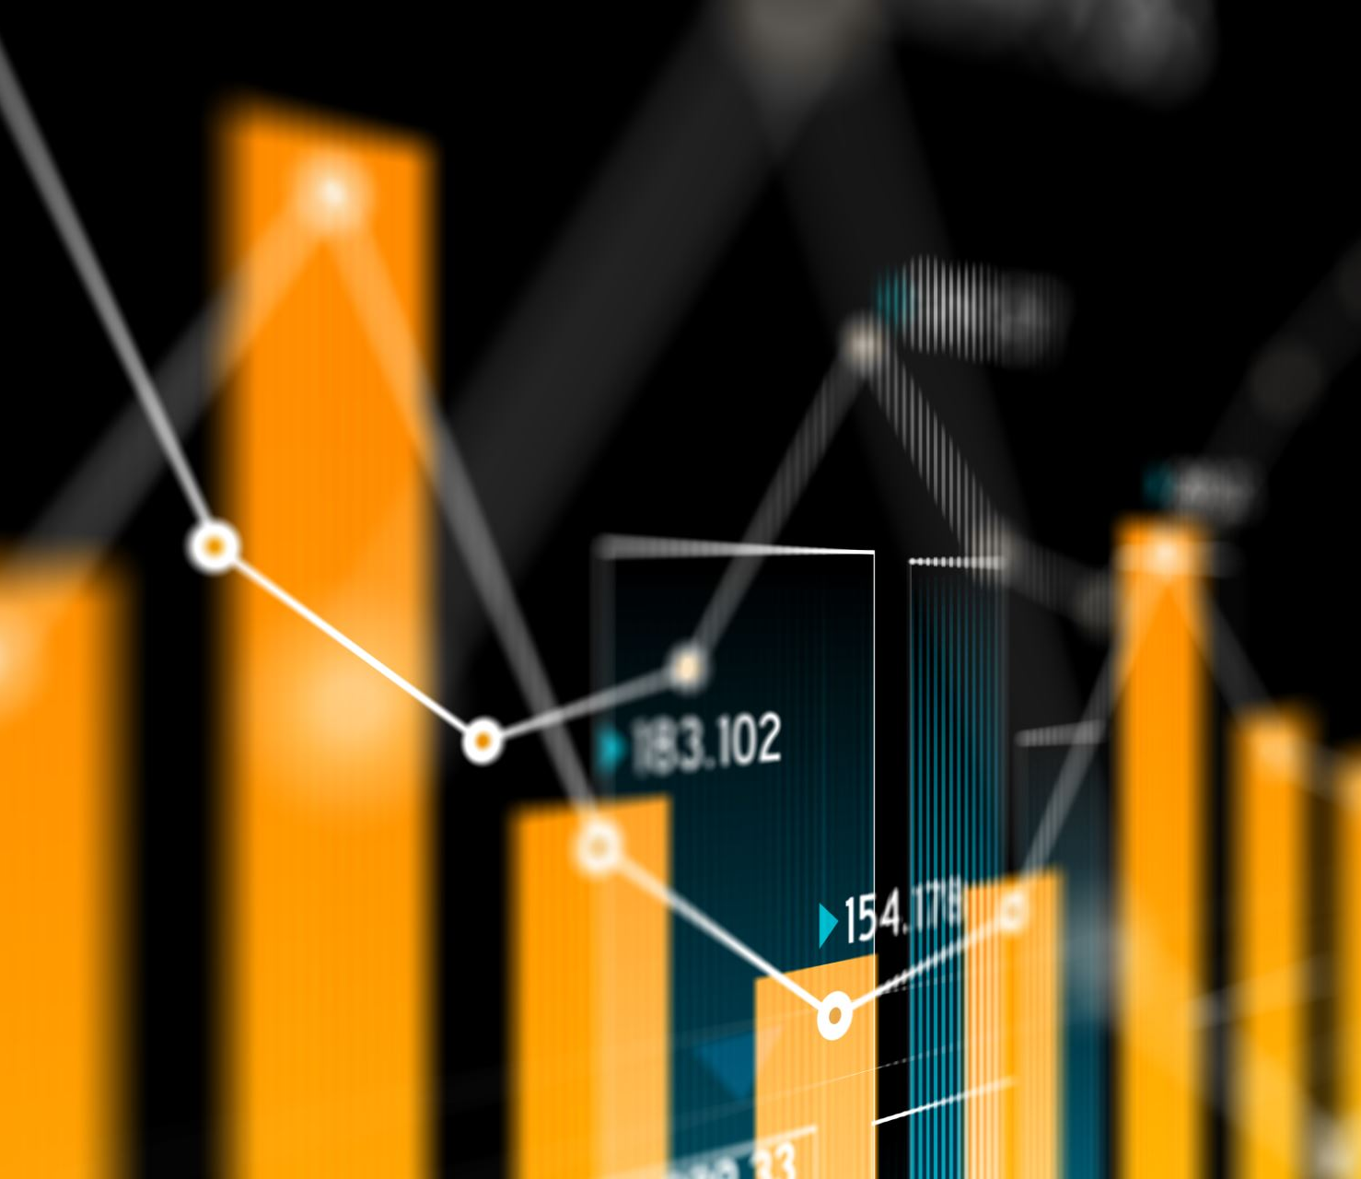
Data
The topics chosen for this project were: Clean Energy, Renewables, Solar Panels, Geothermal, Hydro Electricity, Energy Rebates, Electric Vehicles, Coal Power, Natural Gas
Tweets regarding keywords were scraped using the snscrape python package
Image Source: MS Stock Photos

Slide 5
Methods
100k tweets were scraped from Twitter for every other year for the past decade, for the topics mentioned earlier
These tweets were piped into a Mongo DB collection for simple storage and access
Datasets were cleaned and standardized to prepare for sentiment analysis
Sentiment analysis was carried out through the vader python package
The mean sentiments of each year were plotted and compared

Slide 6
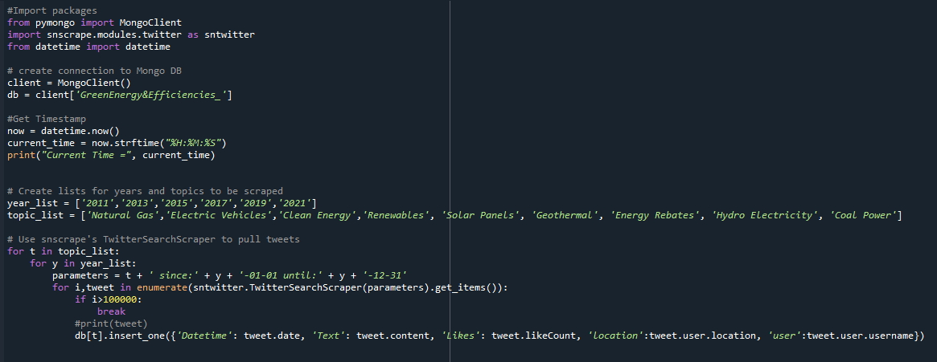

Slide 7
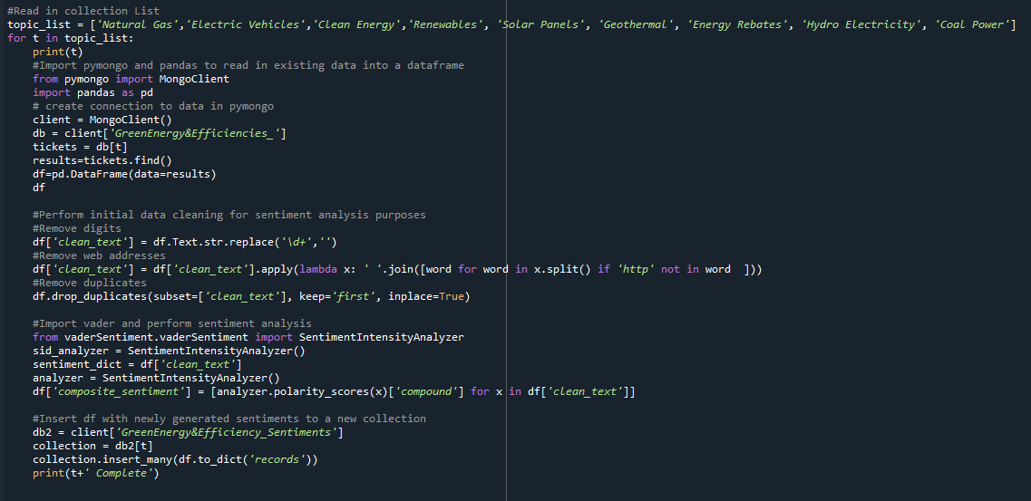

Slide 8
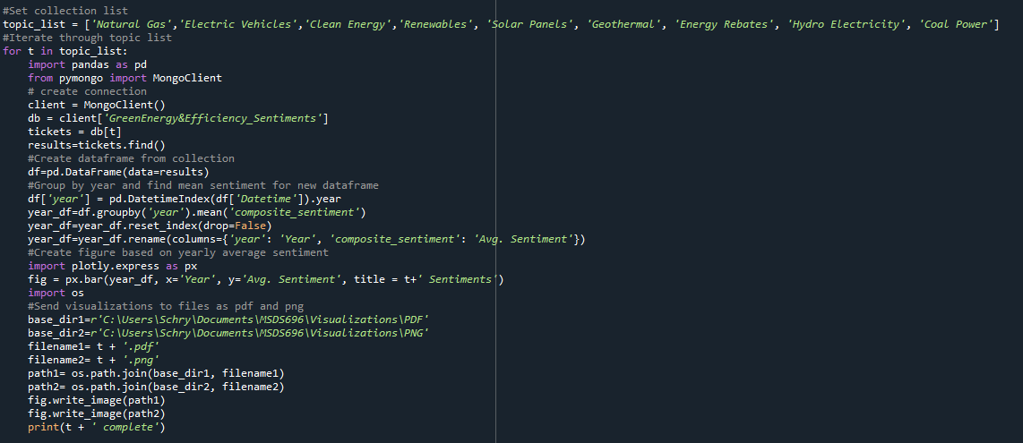

Slide 9
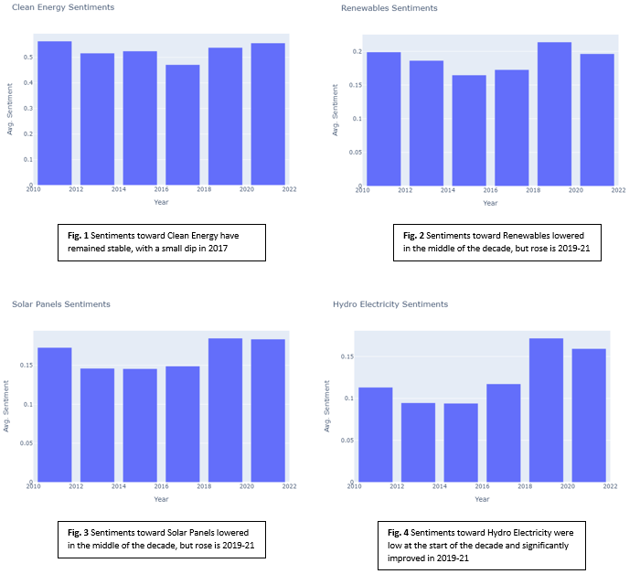
Results

Slide 10
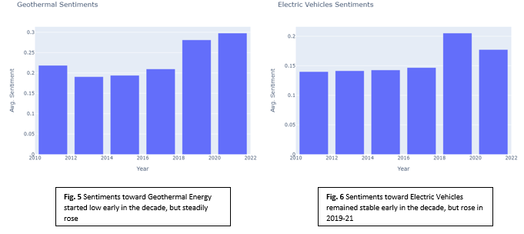
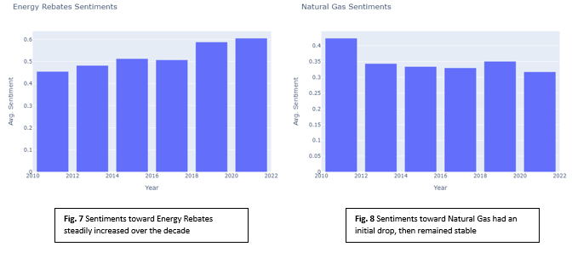
Results Cont.

Slide 11
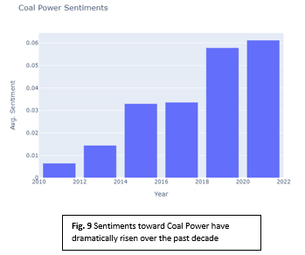
Coal Power Results

Slide 12
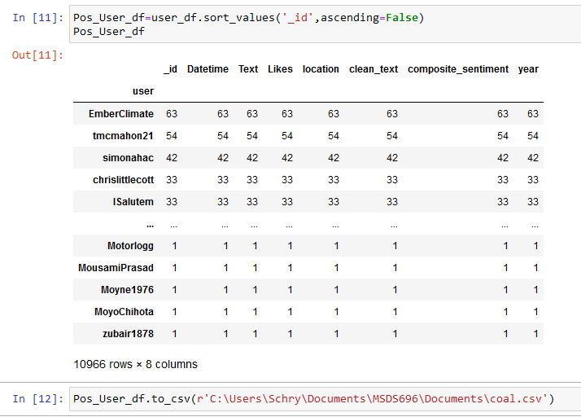
Coal Power Results Cont.

Slide 13
Ember Tweets
BREAKING: All of the world's top 10 coal power countries have now committed to #NetZero Not all are targeting 2050 - but the progress from last year is encouraging. https://t.co/M84ACY4vzK
The best time to end coal power was 109 years ago. The second best time is now. https://t.co/JcTDFmR80Y
Today we were delighted to share our research on India's electricity transition in a workshop with @FCDOGovUK. Ember's report showed that Indiaâ€™s coal power may have already peaked, if it seizes the opportunity.

Slide 14
Conclusion
Through the methodology set forth in this project, sentiment changes can be observed over the past decade for a host of energy related topics. Many of these trends match the expectations of increasing or staying neutral. However, Coal Power trended in an unexpected positive fashion.
It seems that the positive sentiments toward coal power could be due to tweets with positive language speaking about the end to coal power
If continued:
Tweets belonging to governments, companies, and organizations would be removed
Time would be invested to develop a custom sentiment classification model
The results of this model would undergo rigorous accuracy testing
There would be further exploration of the correlation between sentiments and likes
Lastly, there would be an exploration between tweet location and sentiments on various topics.

